Slide 1
Livingston Parish Louisiana
Conveniently located east of Baton Rouge and North West of New Orleans.

Slide 2
Overview of Parish
Median Income $56,630
4.3% unemployment rate
Livingston Parish
145,136 population
12% increase in population since 2010.

Slide 3
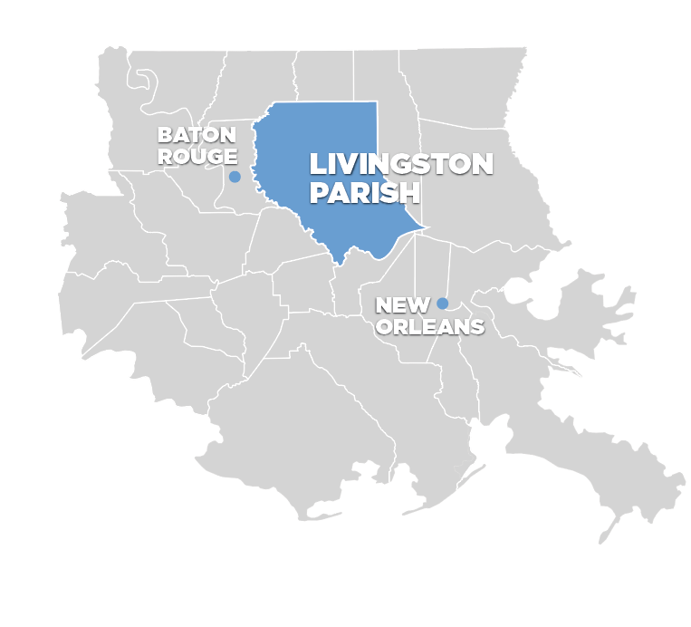
Full Demographics:

Slide 4
Business Climate
Location
  Located between New Orleans and Baton Rouge
  Located at the nexus of three major interstates – Interstates 10, 12 & 55
Workforce
  Skilled regional workforce
  Available talent from colleges, universities, and technical college programs
Livingston Parish
Transportation
  I-12 and US 190 bisect the parish from east to west
  CN mainline runs adjacent to US 190 through the parish
  Interstate network link us to nearby ports and airports
Sites
  Available land
  Affordable prices
  Two LED State-Certified industrial sites

Slide 5
Incentives
The Parish of Livingston and its municipalities are supportive of business recruitment. They stand behind Louisiana Economic Development’s incentive programs.
Please click here for a list of available incentives in our parish.

Slide 6
Livingston Parish
Employee Lifestyle in
Top Schools
Waterway & Park Activities
Safe Neighborhoods
Employee Lifestyle
Entertainment
Retail
Shopping

Slide 7
Contact LEDC Staff
David Bennett
President & C.E.O.
Office: (225) 686-3982
Cell: (225) 933-3774
Email: david@ledc.net
Website: www.ledc.net
Abigail DePino
Vice President
Office: (225) 686-3982
Cell: (225) 938-3343
Email: Abigail@ledc.net
Website: www.ledc.net

